Slide 1
EMPLOYEE MANAGEMENT SYSTEM
NAME: ASIF KOTLA DATE: JANUARY - 2025

Slide 2

INTRODUCTION
NEED FOR EMPLOYEE MANAGEMENT SYSTEMS
An Employee Management System centralizes employee data, streamlining the management process. It automates routine tasks and provides a scalable solution for organizations of any size.

Slide 3
TECHNOLOGIES USED
These technologies form the backbone of the Employee Management System, ensuring scalability and reliability. Their integration optimizes system performance and usability.
COMPONENT | TECHNOLOGY | DESCRIPTION
Programming Language | C# | Main language for backend development.
Framework | Entity Framework | Framework for Interaction With Data Base Seamlessly
Database | SQL Server | Relational database management system.
Email Service | SMTP Server | Used for handling email notifications.

Slide 4
SYSTEM ARCHITECTURE
MODEL LAYER
LOGIC LAYER
DATA ACCESS LAYER
Handles the data representation of All Data Tables. It defines how employee information is structured with other Tables
Contains the core application logic and workflows. This layer processes commands from the user interface.
Manages interactions with the SQL Server database. It uses Entity Framework Core for data operations.

Slide 5
KEY FEATURES
CRUD OPERATIONS
EMAIL NOTIFICATIONS
ROLE-BASED DASHBOARDS
Our system allows complete management of employee records. Users can add, update, view, and delete employee information seamlessly.
The system sends automated emails for important events. Notifications include password recovery links and alerts for new hires.
Different roles access customized dashboards. Admins, managers, HR, and employees have unique views tailored to their functions.

Slide 6
SECURITY FEATURES
PASSWORD VALIDATION
PASSWORD HASHING
SECURE CREDENTIAL VERIFICATION
The system ensures strong password policies to protect user accounts from unauthorized access. It encourages combining letters, numbers, and symbols.
All passwords are hashed before storage, enhancing security. This means even if data is compromised, actual passwords remain protected.
When users log in, credentials are verified securely to prevent breaches. This process uses encryption and secure channels to strengthen user privacy.

Slide 7
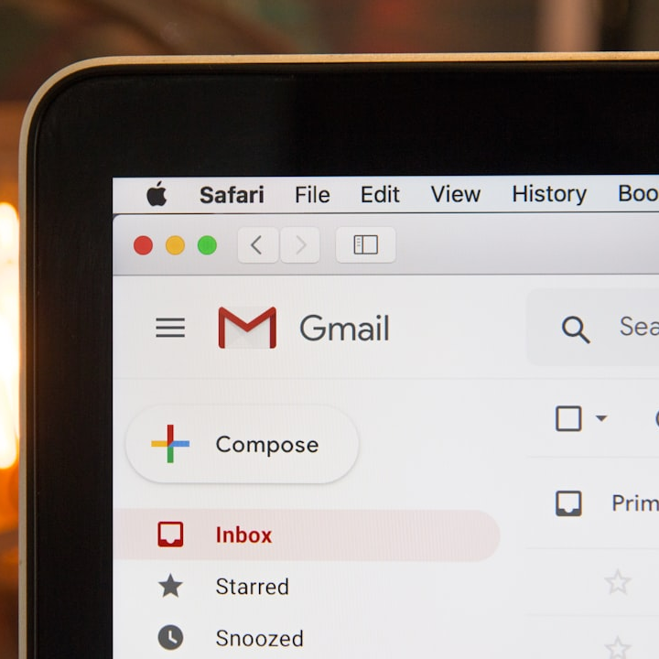

EMAIL NOTIFICATIONS
NEW HIRE ALERTS
When a new employee joins, notifications are sent to relevant parties. This enhances collaboration and keeps everyone informed of changes.
PASSWORD RECOVERY
Users can easily recover their passwords through email notifications that guide them through the process quickly and securely.

Slide 8
SEARCH FUNCTIONALITY
This table summarizes the search options available to enhance user experience. It allows users to efficiently locate employee information with specific criteria.
SEARCH CRITERION | DESCRIPTION | EXAMPLE
ID | Unique identifier for each employee | 12345
Name | Search by employee’s full name | John Doe
Joining Date | Find employees based on their start date | 01/01/2020
Role | Filter employees based on job title | Manager
Department | Search employees by department | Sales

Slide 9
DATABASE STRUCTURE
25%
20%
20%
35%
ADMINS
MANAGERS
EMPLOYEES
HUMAN RESOURCES
Essential for overseeing the system.
Responsible for team management.
Access their own records.
Manages employee records.

Slide 10
GENERATE REPORTS MODULE

Slide 11

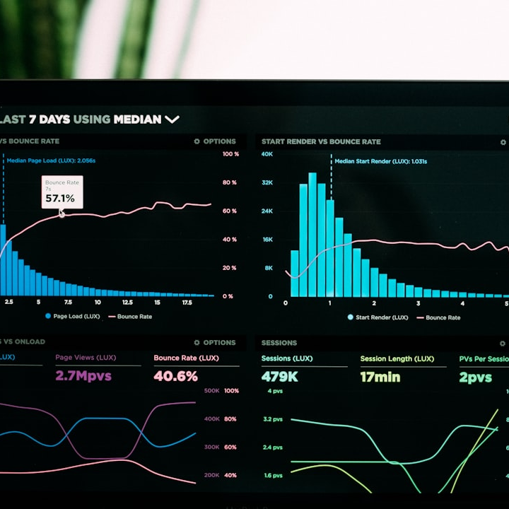
ADMIN REPORTS
EMPLOYEE REPORT BY DEPARTMENT
This report lists all employees categorized by department. It provides insights into departmental structure and employee distribution.
DEPARTMENT HEADCOUNT
This report displays the current headcount of employees in each department. It aids in workforce management and planning by highlighting staffing levels.

Slide 12
ADMIN REPORT SUMMARY
The table summarizes the report options available for Admins. Each report serves a specific purpose in employee management.
REPORT NAME | DESCRIPTION
Department Headcount | Current headcount per department
Employee Report By Department | Employees categorized by department
Department Salary Distribution | Salary distribution among departments
Salary Report | Detailed breakdown of employee salaries

Slide 13

MANAGER REPORTS
TASK COMPLETION STATUS REPORT
This report outlines the completion status of tasks across the organization. It highlights efficiency and areas needing attention.
EMPLOYEE TASK REPORT BY EMPLOYEE ID
This report tracks individual employee tasks. It facilitates performance management by showcasing task assignments and completion status.

Slide 14
MANAGER REPORT SUMMARY
This summary outlines the types of reports available for managers, emphasizing their role in tracking employee performance and task management.
REPORT NAME | DESCRIPTION
Employee Task Report by Employee Id | Tracks individual task assignments
Task Completion Status Report | Shows completion status of tasks
Employee Performance Report | Evaluates employee performance metrics
Pending Task | Lists tasks that are yet to be completed

Slide 15


HR REPORTS
DEPARTMENT WISE BUDGET
This report presents budget allocation for each department. It aids in financial planning and resource management.
TOP PERFORMER
This report identifies the top performing employees across the organization. It serves as a tool for recognition and talent management.

Slide 16
HR REPORT SUMMARY
This table provides a concise overview of reports available for HR functions, critical for workforce planning and management.
REPORT NAME | DESCRIPTION
Top Performer | Identifies top talent in the organization
Department Wise Budget | Shows financial resources per department
Department Wise Pending Task | Lists tasks pending in each department
Resigned Employees With Their Contribution | Details contributions of resigned employees
Department Wise Headcount | Summarizes employee count per department

Slide 17
TASK MODULE

Slide 18

MODULE OVERVIEW
PURPOSE OF THE TASK MODULE
The Task Module streamlines task management processes within an organization. It allows for efficient task assignment, tracking, reporting, and management of responsibilities.

Slide 19


ROLES & RESPONSIBILITIES
EMPLOYEE'S ROLE
Employees can view assigned tasks with deadlines. They are empowered to update task statuses to reflect progress.
MANAGER'S ROLE
Managers can assign tasks to employees based on workload and skills. This ensures proper distribution of tasks and accountability.

Slide 20
TASK FEATURES
TASK ASSIGNMENT
REPORT GENERATION
STATUS MANAGEMENT
Managers can easily assign and track tasks, ensuring all employees have clear directives and necessary resources.
HR, managers, and admins can generate detailed reports on task deadlines, statuses, and overall progress, facilitating better oversight.
Employees can change task statuses to Pending or Completed, reflecting real-time progress and workflow efficiency.

Slide 21
TASK STATUS OPTIONS
This table summarizes various task statuses along with their descriptions. Understanding these statuses is crucial for effective task management.
STATUS | DESCRIPTION
In Progress | Task is currently being worked on.
Pending | Task is assigned but not yet started.
Completed | Task has been finished and verified.
Delayed | Task has not been completed by the deadline.

Slide 22
REPORTING BY ROLE
40%
20%
10%
30%
MANAGERS
ADMINS
EMPLOYEES
HR
Managers have a 40% capability to generate reports on task status.
Admins can generate 20% of reports on the task module.
Employees have a 10% capability to generate their own task reports.
HR possesses a 30% capability for generating reports related to tasks.

Slide 23

MODULE BENEFITS
ORGANIZATIONAL EFFICIENCY
The Task Module enhances productivity and accountability by clearly defining roles, streamlining task assignments, and enabling comprehensive reporting.

Slide 24

FUTURE ENHANCEMENTS
PLANNED IMPROVEMENTS
Enhancements include role-based access control for security,
cloud service integration,
and advanced analytics for better insights.
Migrate Console Application to Web Application using ASP.NET and MVC
Use WEB API for Notifications On Contact Numbers
Additional features like attendance tracking, Leave Management will be added.

Slide 25

CONCLUSION
RECAP OF MAIN POINTS
The Employee Management System simplifies record handling through features like CRUD operations and robust security. Email notifications streamline communication, while role-based dashboards enhance user access. Ultimately, it boosts workplace efficiency.

Slide 26

THANK YOU!
FEEDBACK AND QUESTIONS
We appreciate your time sharing this presentation. Please feel free to ask any questions or provide feedback about the system and its functionalities.

